Slide 1
Dopamine arithmetics
Configuration:
Perlin size: 4 (base/seed: 1), sig_{EE}=5, sig_{II}=5
J=2, g=6.5, ext. drive=20+-20
Nrows=70, p=20%, seed=912
Transfer function: steepness=0.5, x0=50

Slide 2
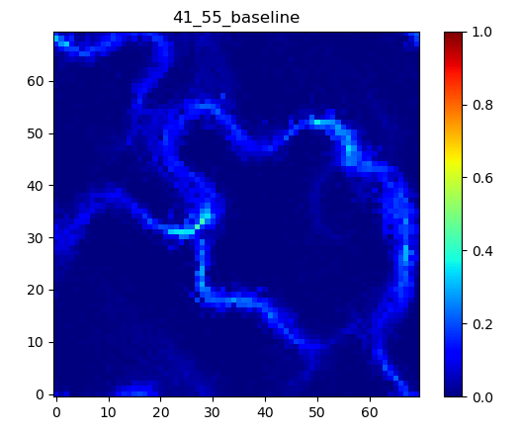
Baseline simulation
Most sequences go from right to left.
Diverging at (20, 50) and (58, 14)
Converging at (30, 30) and (68, 30)
Fading at (26, 30), (18, 50), and (55, 14)

Slide 3
Patch placed orthogonal to STAS direction
In-, edge-, and out- patch
Interestingly, the second set (my first idea) lead to quite interesting result, acquiring a new path. Thus the PCA also gives exciting results here.

Slide 4
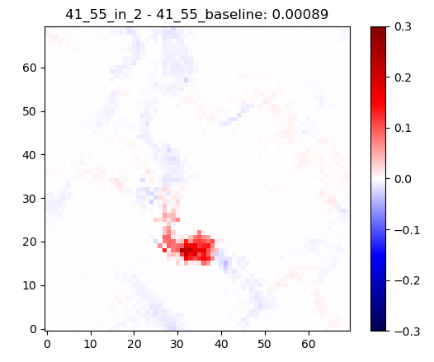
In patch @(35, 18), r=4
Increasing the (avg.) activation in and past the patch
Reducing the avg. activation prior to the patch

Slide 5
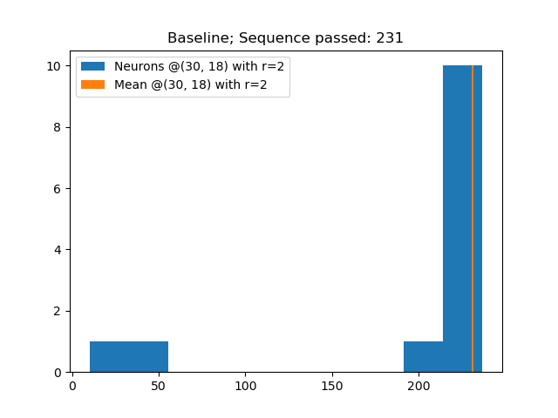
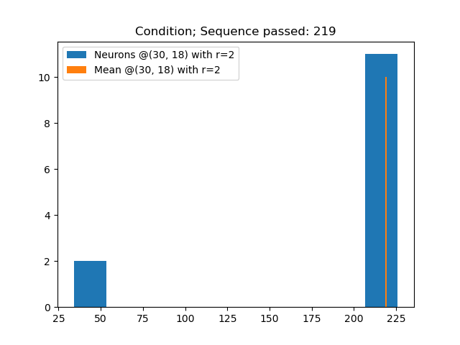
Sequence passing by

Slide 6
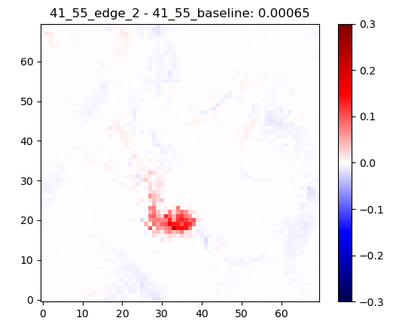
edge patch @(35, 21), r=4
Increasing the (avg.) activation in and past the patch
Reducing the avg. activation prior to the patch
Effect is smaller compared to the in-patch
No. of sequence analysis need to be done.

Slide 7
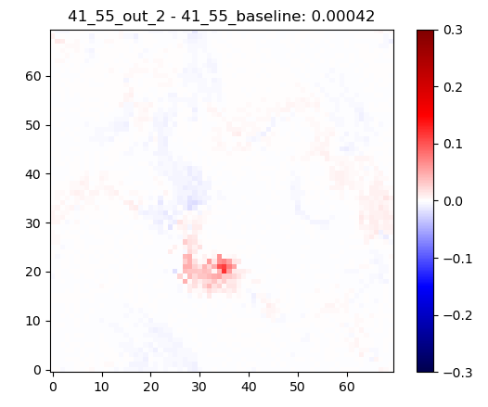
out patch @(35, 24), r=4
Increasing the (avg.) activation in and past the patch
Reducing the avg. activation prior to the patch
Effect is smaller compared to the in-patch and edge-patch
No. of sequence analysis need to be done.

Slide 8
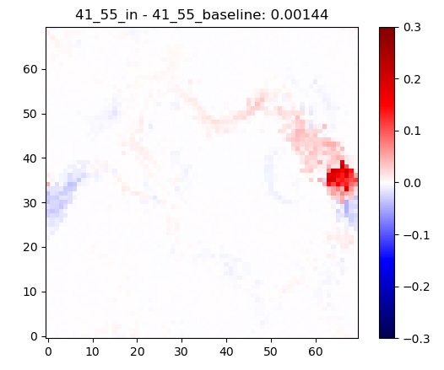
in patch @(66, 34), r=4
Increasing the (avg.) activation in and past the patch
Reducing the avg. activation prior to the patch
No. of sequence analysis need to be done.

Slide 9
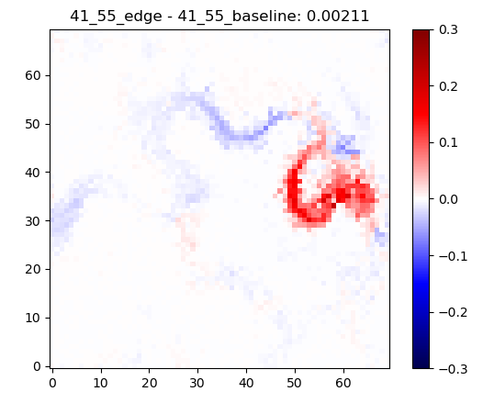
edge patch @(63, 34), r=4
A new path is acquired
Complex changes along the paths
No. of sequence analysis need to be done.

Slide 10
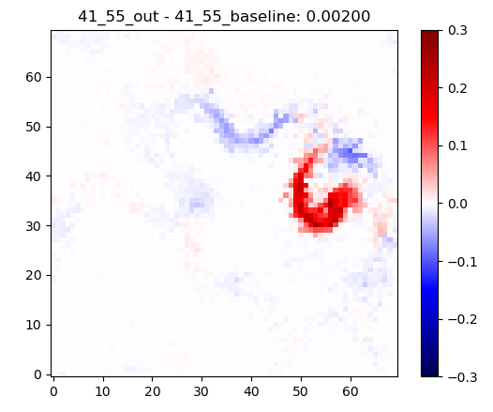
out patch @(59, 34), r=4
A new path is acquired
Complex changes along the paths
No. of sequence analysis need to be done.

Slide 11
Patch locations along the sequence
Starter patch
Repeater patch
Linker patch
Effectively changing the sequence pattern occurring in the network. Thus, the combination of the patches allows for arithmetics of sequences. Simple binary operations are possible.

Slide 12
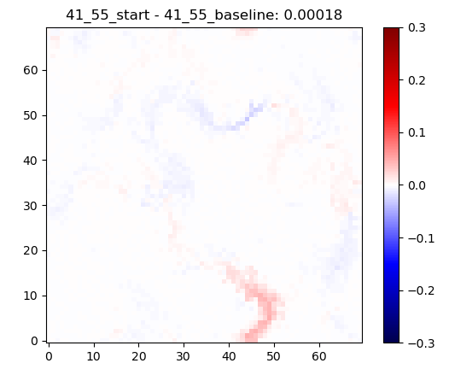
starter patch @(43, 68), r=4
Increasing the (avg.) activation in and past the patch (see the red pixels on the bottom)
No. of sequence analysis need to be done.

Slide 13
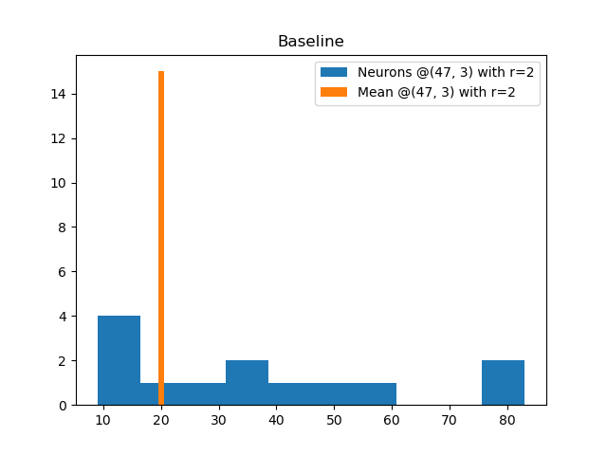
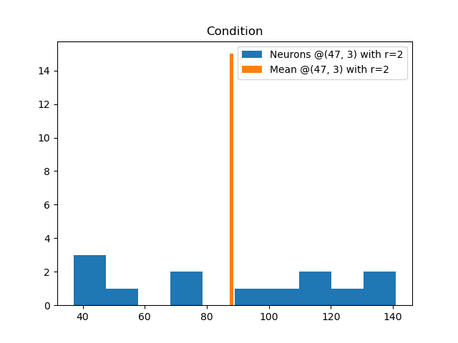
Sequence passing by

Slide 14
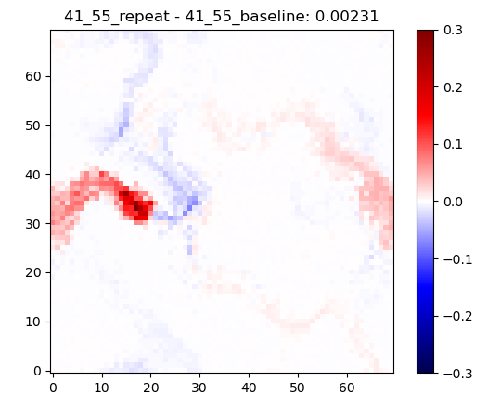
repeater patch @(17, 34), r=4
Increasing the (avg.) activation in and past the patch
Alters other sequences (see upper one)
No. of sequence analysis need to be done.

Slide 15
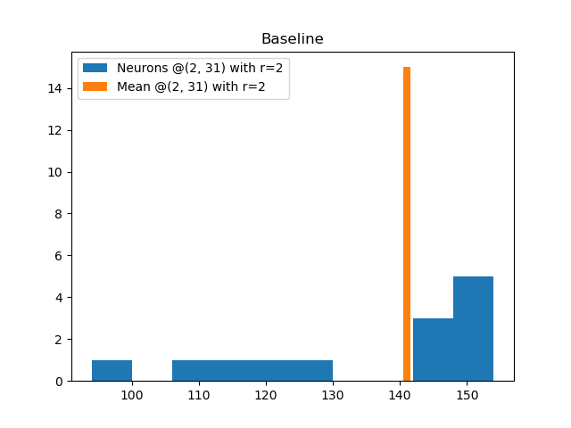
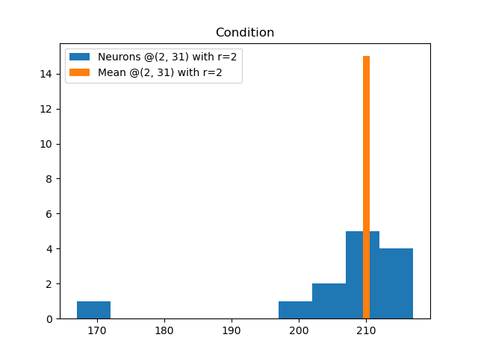
Sequence passing by

Slide 16
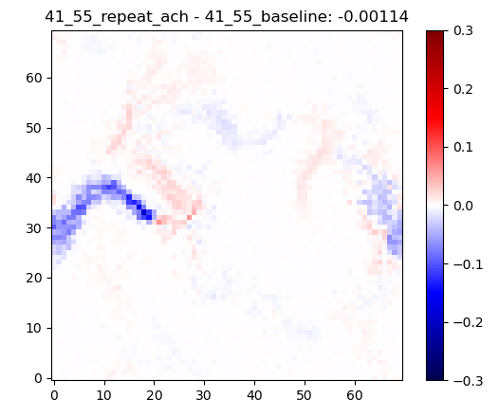
repeater patch (ACh) @(17, 34), r=4
Decreasing the (avg.) activation in and past the patch
Alters other sequences (see upper one)
No. of sequence analysis need to be done.

Slide 17
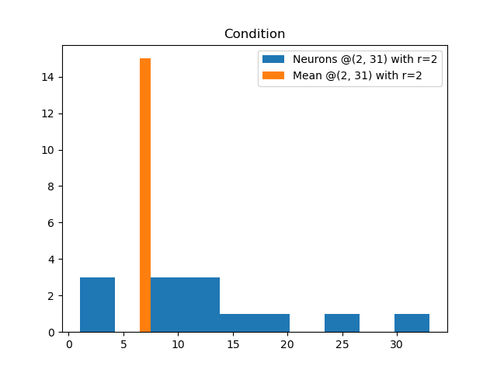
Sequence passing by

Slide 18
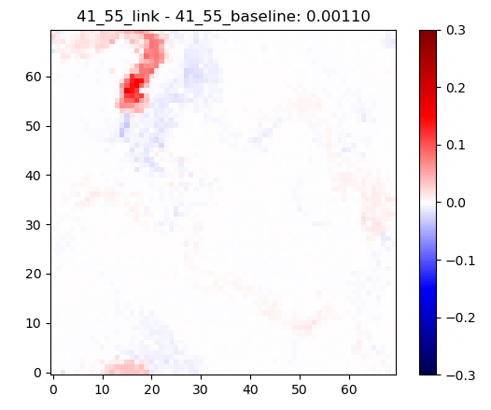
linker patch @(16, 56), r=4
Increasing the (avg.) activation in and past the patch
Alters other sequences (see right beside it)
No. of sequence analysis need to be done.

Slide 19
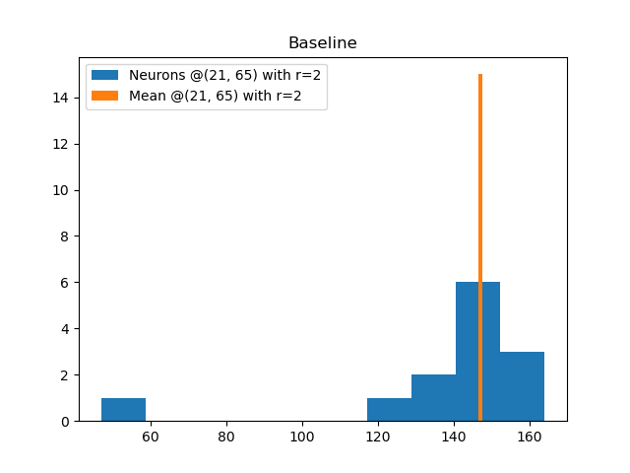
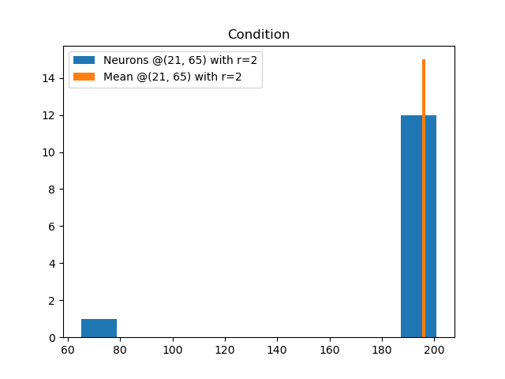
Sequence passing by

Slide 20
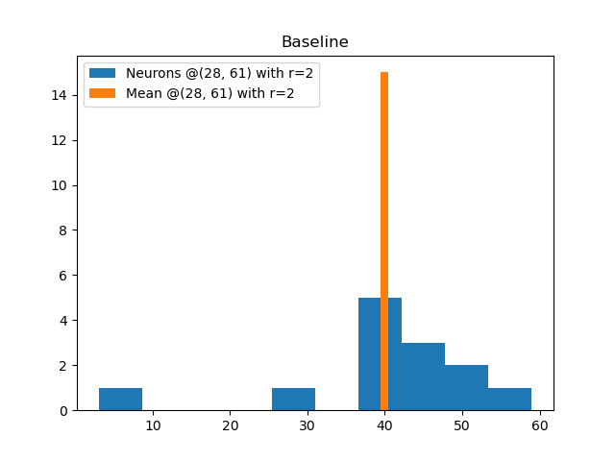
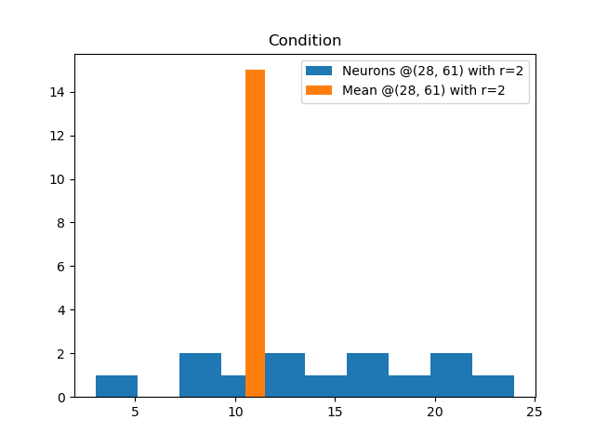
Neighboring sequence passing by

Slide 21
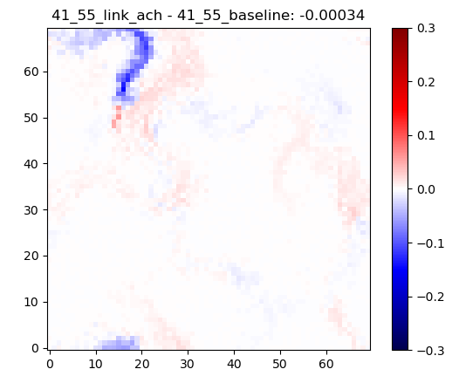
linker patch (ACh) @(16, 56), r=4
Decreasing the (avg.) activation in and past the patch
Alters other sequences (see right beside it)
No. of sequence analysis need to be done.

Slide 22
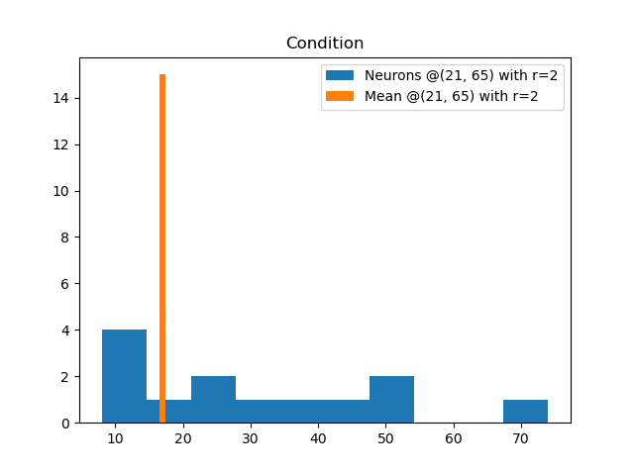
Sequence passing by

Slide 23
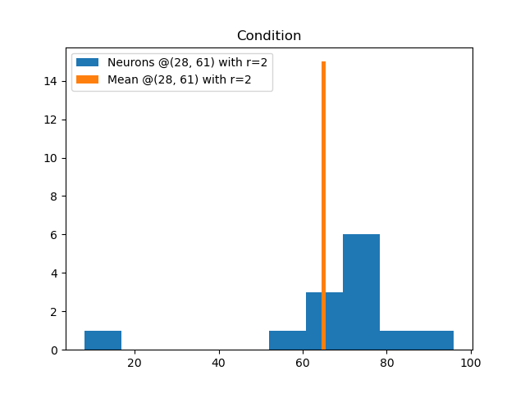
Neighboring sequence passing by

Slide 24
Manifold analysis
Comparing the manifolds of the different patches on a local level (@patch but with a larger radius of 8 instead of 4), and on a global level (everything than the local part)

Slide 25
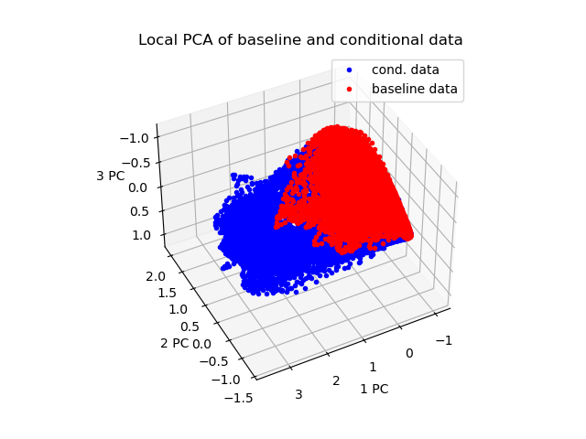
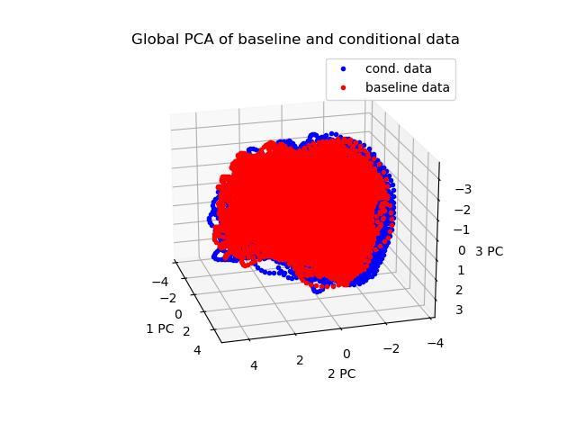
Repeater (17, 34)

Slide 26
Repeater (17, 34)
Local: More exploration in the PCA-space, and thus in the neural space
Global: No visible effect

Slide 27
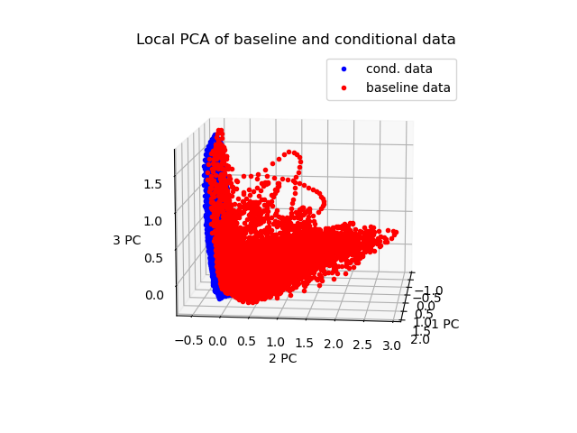
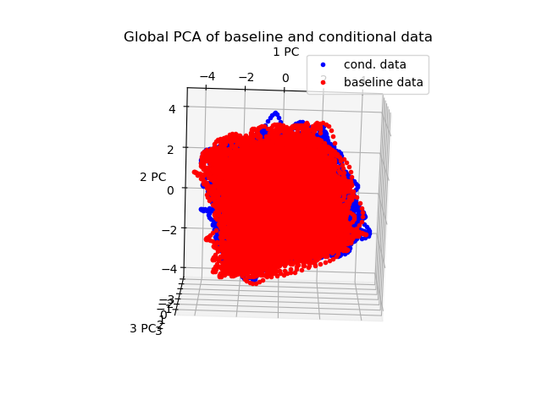
Repeater ACh (17, 34)

Slide 28
Repeater ACh (17, 34)
Local: Much less exploration in the PCA-space, and thus in the neural space
Global: No visible effect

Slide 29
Linker (affecting neighboring sequences)
As we observed in the no. of sequences passed by the linked branch, and the neighboring branch, we expect a strong deviation of the manifolds
Interestingly, the conditional simulation (DP and ACh) lead to a rather disc-like shape of the activity in the PC space. So without any patch, the neural space is exploited more intensiv.

Slide 30
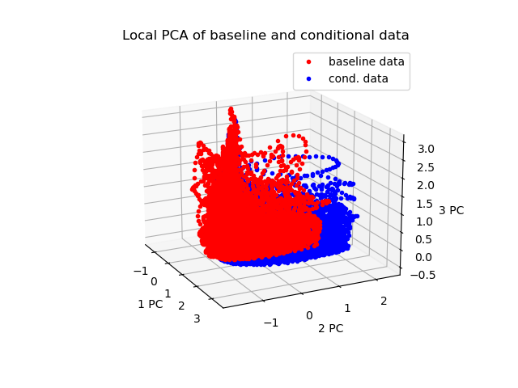
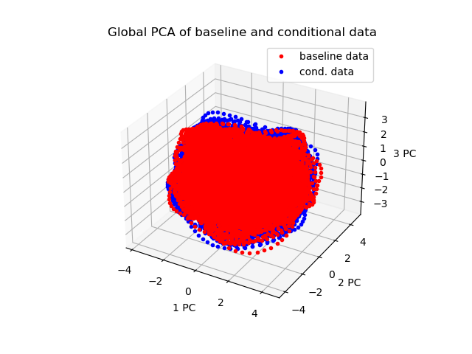
Linker (24, 64)

Slide 31
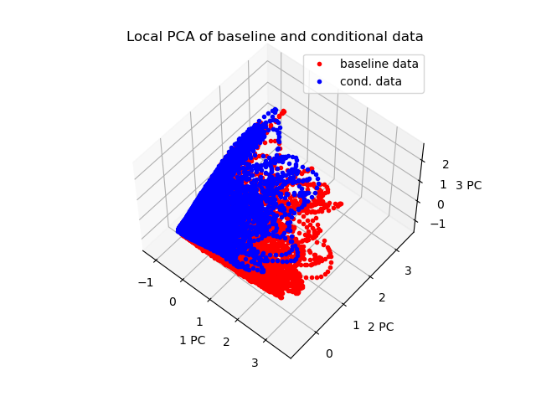
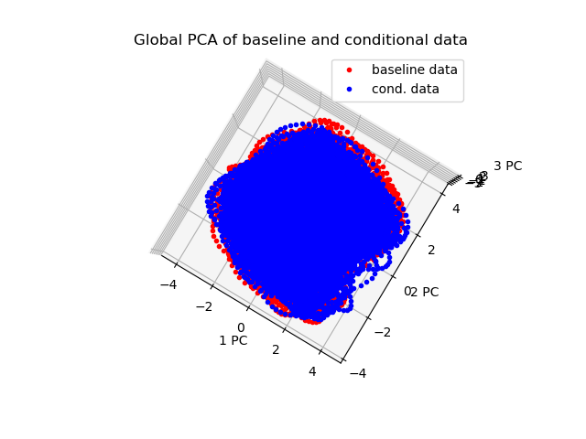
Linker ACh (24, 64)

Slide 32
Edge (exploring a new path)
Expectation: High deviation of the manifolds
Result: The PCA in the local area around the patch shows a butterfly. Seems to explore more PC sapce, hence more neural space

Slide 33
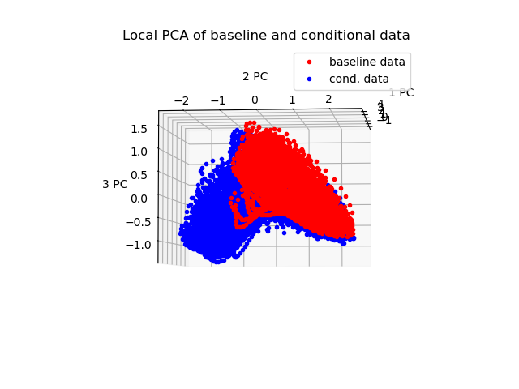
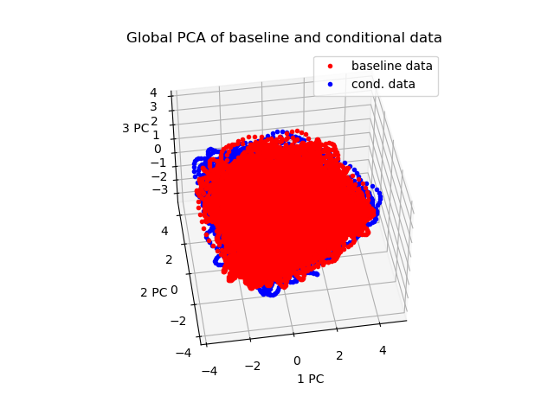
Edge (64, 35)

Slide 34
Control
The same number of neurons as one patch comprises are sampled randomly
Increase of 20% of the incoming syn. weights

Slide 35
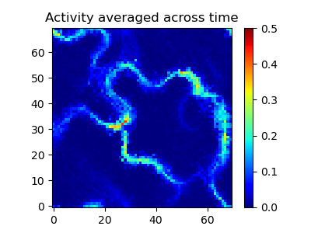
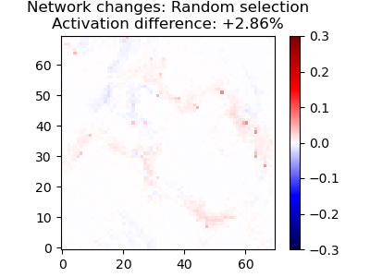
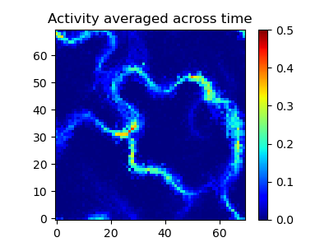
Control
Baseline (upper) and control (lower)

Slide 36
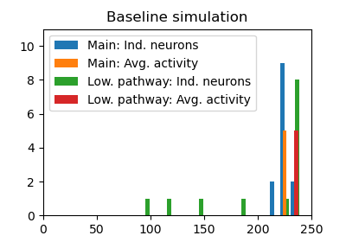
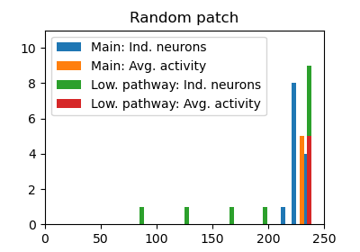
Control
Slightly stronger activation in the pathways
The Main is measured at (66, 34) (close to the activator patch), and the lower pathway observed the sequences at (35, 18) (see in-patch)
The no. of detected sequenced raised from 225 to 230, and from 236 to 237, respectively.

Slide 37
Control
Symmetric layout
Increase of 20% of the incoming syn. weights

Slide 38
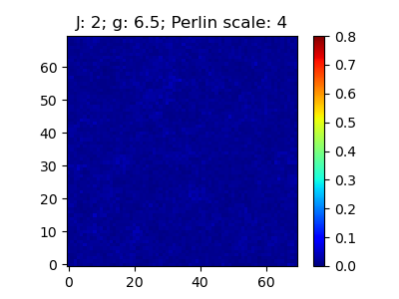

Repeater

